Slide 1



EffiGO
Process to Progress

Slide 2

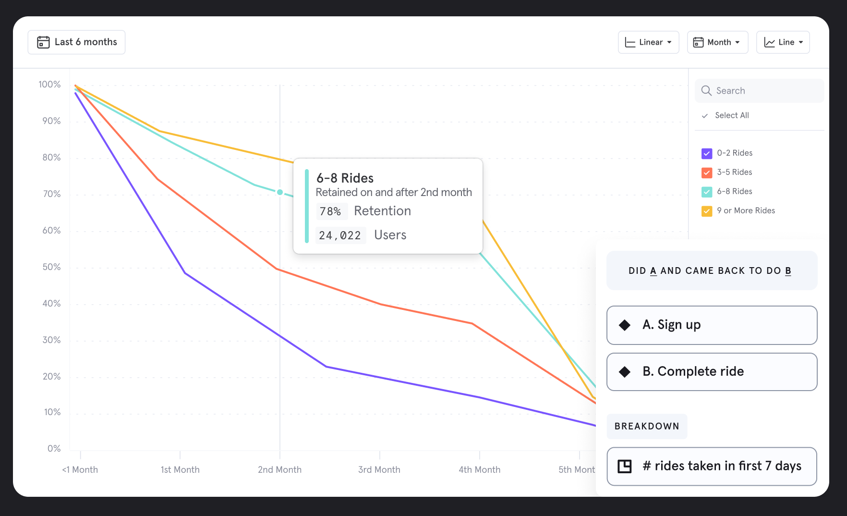
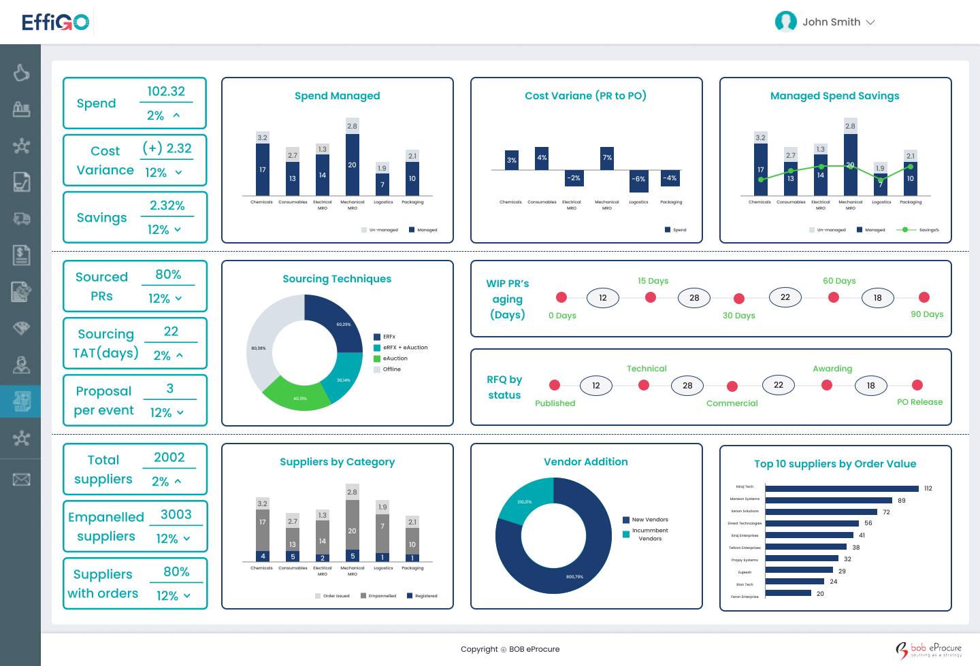
WHO ARE WE?
We are a cloud-based global procurement tech-solution provider.
SynapOne makes custom-fit offerings delivering maximum benefit to organizations and help them take a 360° approach towards their procurement and support activities.

Slide 3







Our Comprehensive Platform: An Overview
360° Procurement Digitization & Automation
Reporting
Sourcing
Contract
Supply Base
PR to PO
Supply Chain
Invoicing
B u s i n e s s P r o c e s s e s
Historical Spend
Capital Project Sourcing
Custom Collaboration
Support for Schedules, work orders, Returns
Acceptance at Local & 3rd Party Warehouse
Reconciled Invoices
Category Reporting
Plan Based Sourcing
Contract Repository
Schedules, WO,
Commodity Purchase
Support for Smart Logistics
Improve Working Capital
Supply Base Reporting
Attribute based Evaluation
Electronic Signature
Service & Milestones Collaboration
Complex Scenarios
Rejections and Credit
Support for Taxation
Procurement Demand
Centralized Sourcing
3rd Party Connect
Exchange P2P Docs
Real Time Budgeting
Sync with ERPs
OK to Pay Process
Category Mgmt.
Complex Sourcing
Contract Mgmt.
Supplier Collaboration
Direct Materials
Inventory & Logistics
Advanced Invoices
Central Dashboard
Savings Mgmt.
Compliance Mgmt.
Supplier Relations
PR to PO
GRN & SES
Settlement
CPO Dashboard
RFI
Contract Execution
Register
PR and Shopping Carts
Goods Receipt
3 Way Match
Process Mining Reports
RFQ, RFPs & Tendering
Contract Performance
Qualify & Empanel
Catalogues
SES and Milestones
Custom Rules
Compliance Report
eAuctions
Evaluate
Policy Management
Support for Blanket and consignment orders
Exception Handling
Multi-Source Data
Savings Scenarios
3rd Party Data & Extensions
Custom Workflows
Support Risk Mitigation

Slide 4



Public Procurement Solution
Enhanced Supply Chain Activity with EffiGO
eTendering
Supplier Portal
Reverse Auction
Ensure compliance and maximize competition, enabling efficient and effective management of the tendering process from start to finish.
Easily onboard new suppliers and collaborate with existing ones, ensuring efficient communication and a stronger overall supplier relationship.
Use our intuitive and user-friendly interface to create, manage, and monitor your reverse auctions, streamlining the entire process and driving better outcomes.

Slide 5
Enhanced Transparency
SynapOne’s
eTendering
Cost Savings
Robust tendering capabilities that enable federal government organizations to easily create and publish tenders, manage responses, and evaluate bids in a transparent and compliant manner.
360º Quotation Comparison
Improved Supplier Diversity
Automated Workflow Processes

Slide 6
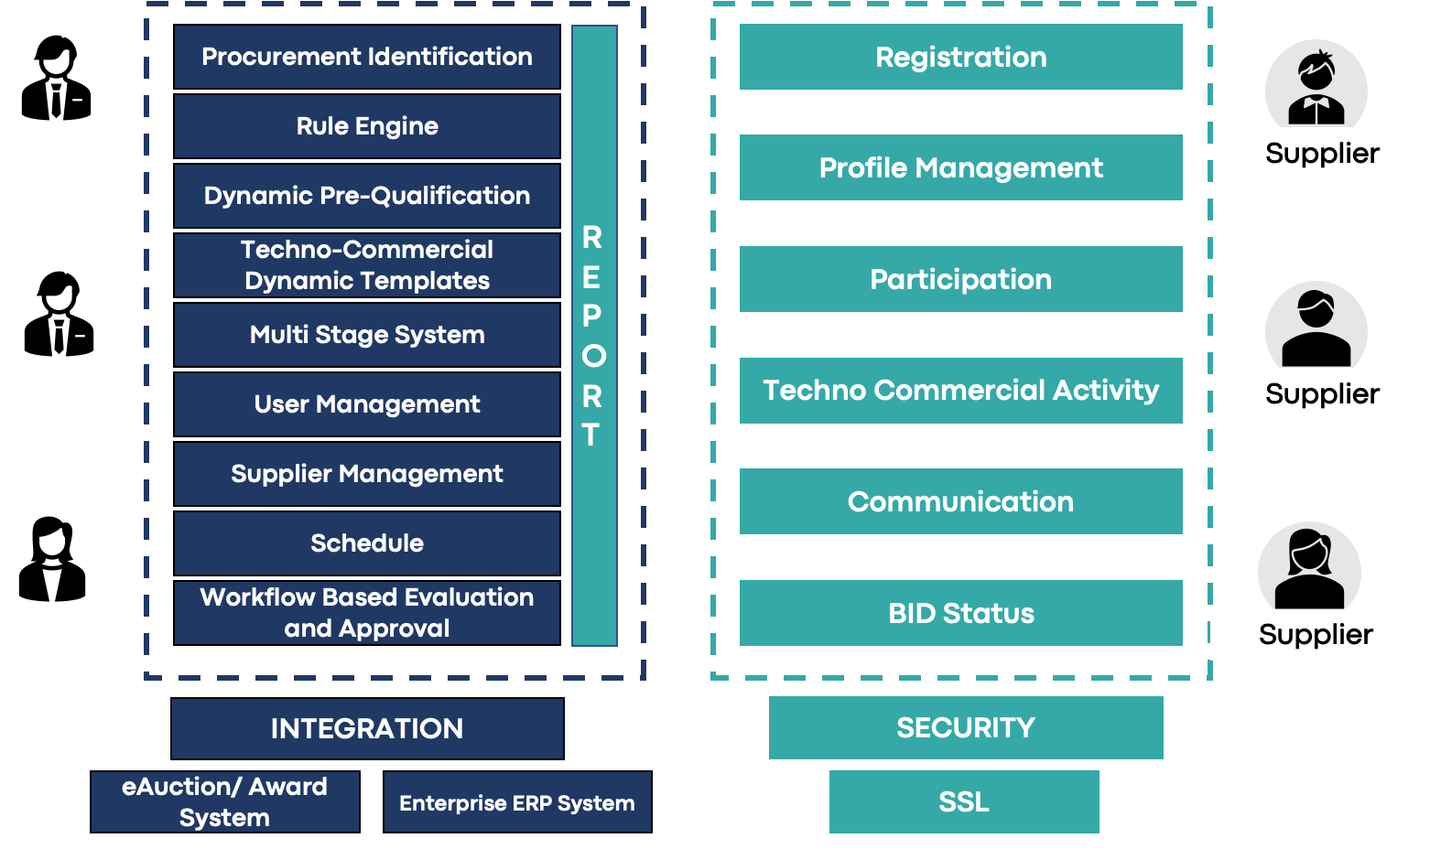
eTendering Environment
Open Tendering Environment
Public availability of tender
Any supplier or contractor can submit a bid
Close Tendering Environment
Tender only available to select group of pre-qualified suppliers or contractors based on past performance, expertise or qualifications
Selection process more limited
Notes:
s

Slide 7
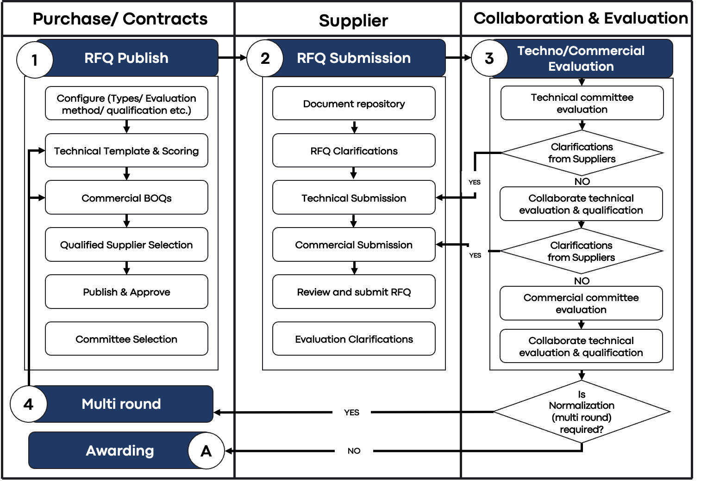
eTendering Workflow

Slide 8
Direct Registration
SynapOne’s
Supplier Portal
Supplier
Categorization
An end-to-end solution for managing supplier relationships, from online profile registration and having online channel of communicating.
Financials, Statutory & Regulatory Info
Supplier Communication
Notifications & Alerts

Slide 9
Supplier Registration & Onboarding
Assessment by Dept/SME 1
Supplier Registration with
Due Diligence
Supplier
Pre-Approval
Due Diligence
Issue Supplier registered Category - Questionnaires
Assessment by Dept/SME 2
Approve and Onboard Supplier
Link Registered List to ERP
Assessment by Dept/SME 3
Supplier Due Diligence
Supplier Evaluation & Approval
Supplier Onboarding

Slide 10
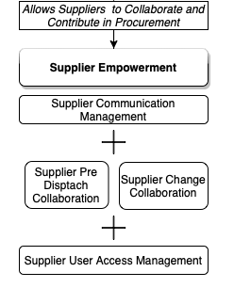
Supplier Collaboration
Communicate.
Manage engineering drawings/ product requirements, new enquiries through the platform itself.
Raise Request
Buyers take the decision. Authorised Buyers get notified
Suppliers can download the components/ finished goods drawings with the latest version from the repository.
Communication all the below activities on the platform.
Purchase order Acceptance
GRN/ SRN status
Advance Shipment Notice
Invoice and payment status

Slide 11
700+ permutations for negotiations
SynapOne’s
Reverse Auction
Best Value Discovery
Benefit from dynamic and flexible negotiations, automated sourcing results and reports, and unlock savings potential & improve productivity.
Empower your buyer teams with the ability to negotiate without constraints and make better decisions.
Auction Management
Run Auction Strategies such as Dutch, English
BOQ Bidding via Microsoft Excel and Comparison

Slide 12
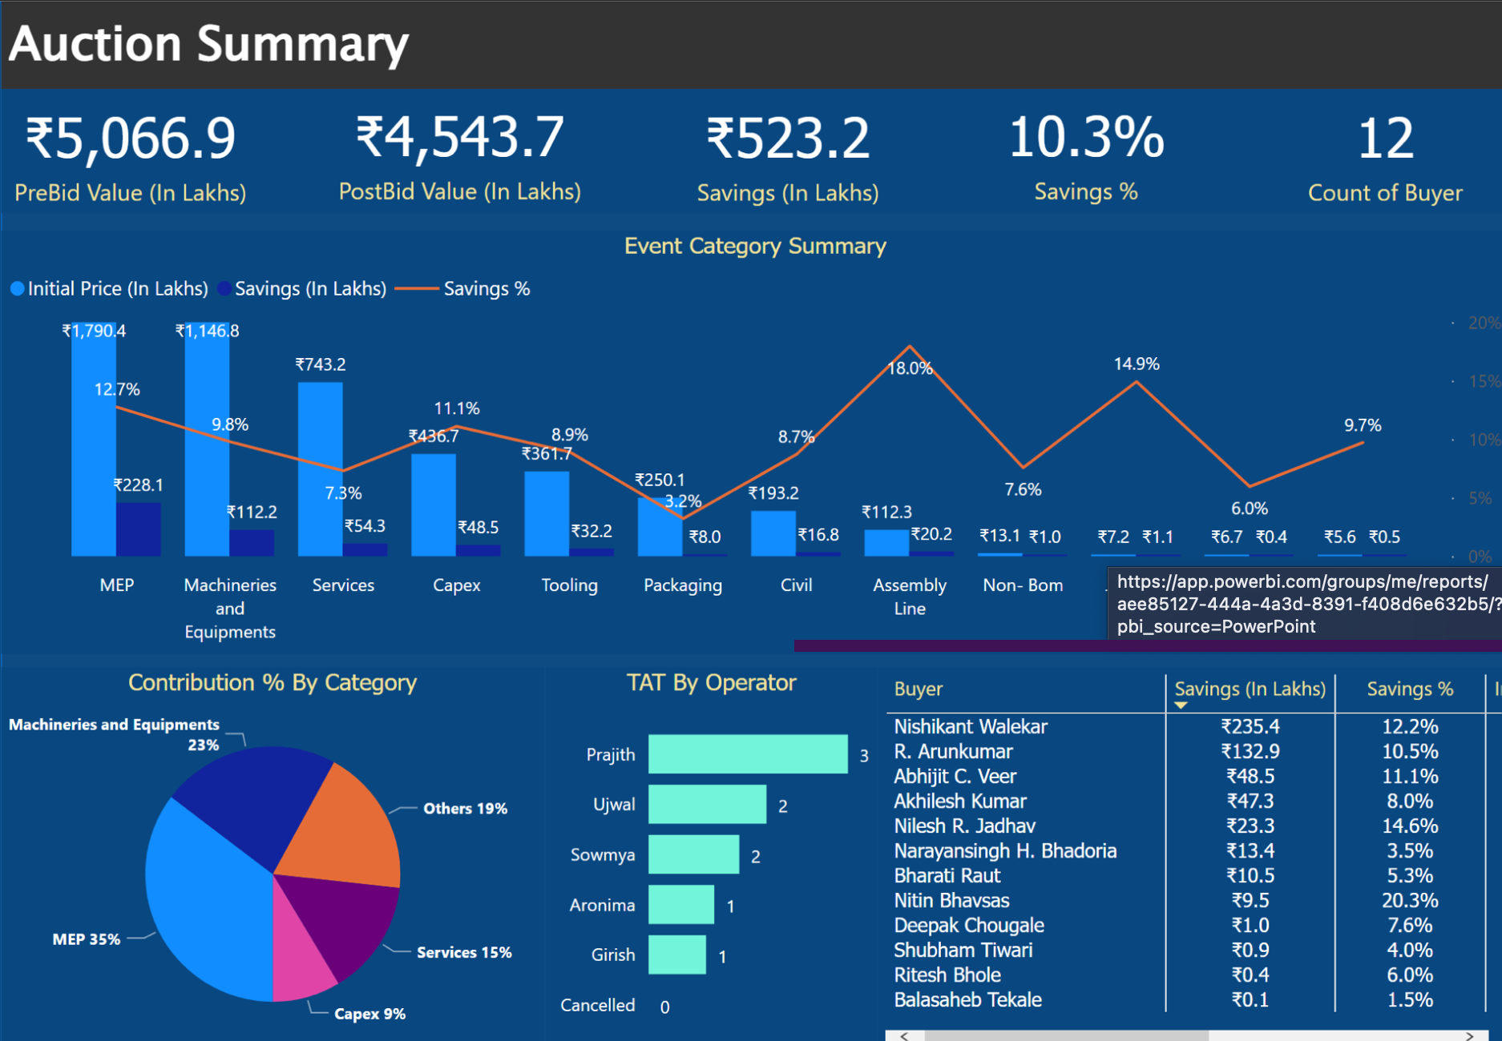
Reverse Auction
1
eAuction Configuration
2
Live Auction
3
Auction Report Post-Bid
Acceptance & Documentation
a
Project/ Package details
Online Communication
Sealed Quotes
$
$
$
b
Framework/ Rules Configuration
Dynamics Bidding
c
Quality & Pricing Conditions
Supplier Group
d
Sequencing & Timing
Buyer Group
Dynamic Bidding View
Queries Responses
Graphical Monitoring
Savings Analytics

Slide 13
Thank You!
Effigo@SynapOne.com

